Slide 1
Secure Data Hiding in Image Using Steganography
CAPSTONE PROJECT
Presented By: Nishi
Student Name : Nishi
College Name & Department : Manipal university Jaipur

Slide 2
OUTLINE
Problem Statement
Technology used
Wow factor
End users
Result
Conclusion
Git-hub Link
Future scope

Slide 3
Problem Statement
With the increase in cyber threats, protecting sensitive information has become a major concern. Traditional encryption methods often attract attention, whereas steganography provides a way to hide messages within images discreetly. This project implements a simple yet effective image steganography technique to encode and decode secret messages within image pixels.

Slide 4
Technology used
Programming Language: Python
Libraries: OpenCV (cv2), OS, String Handling
Platform: Any system supporting Python( I have used VS code IDE)

Slide 5
Wow factors
Secret Communication: Allows users to hide messages within images for secure transmission.
Password Protection: Only users with the correct passcode can decrypt the hidden message.
No Visual Clues: The modified image looks almost identical to the original, making detection difficult.
Lightweight Implementation: The project uses minimal resources, making it efficient.

Slide 6
End users
Cybersecurity Enthusiasts – Interested in data hiding techniques.
Journalists & Whistleblowers – Secure communication without attracting attention.
Law Enforcement Agencies – For undercover communication.
General Users – To send private messages securely.

Slide 7
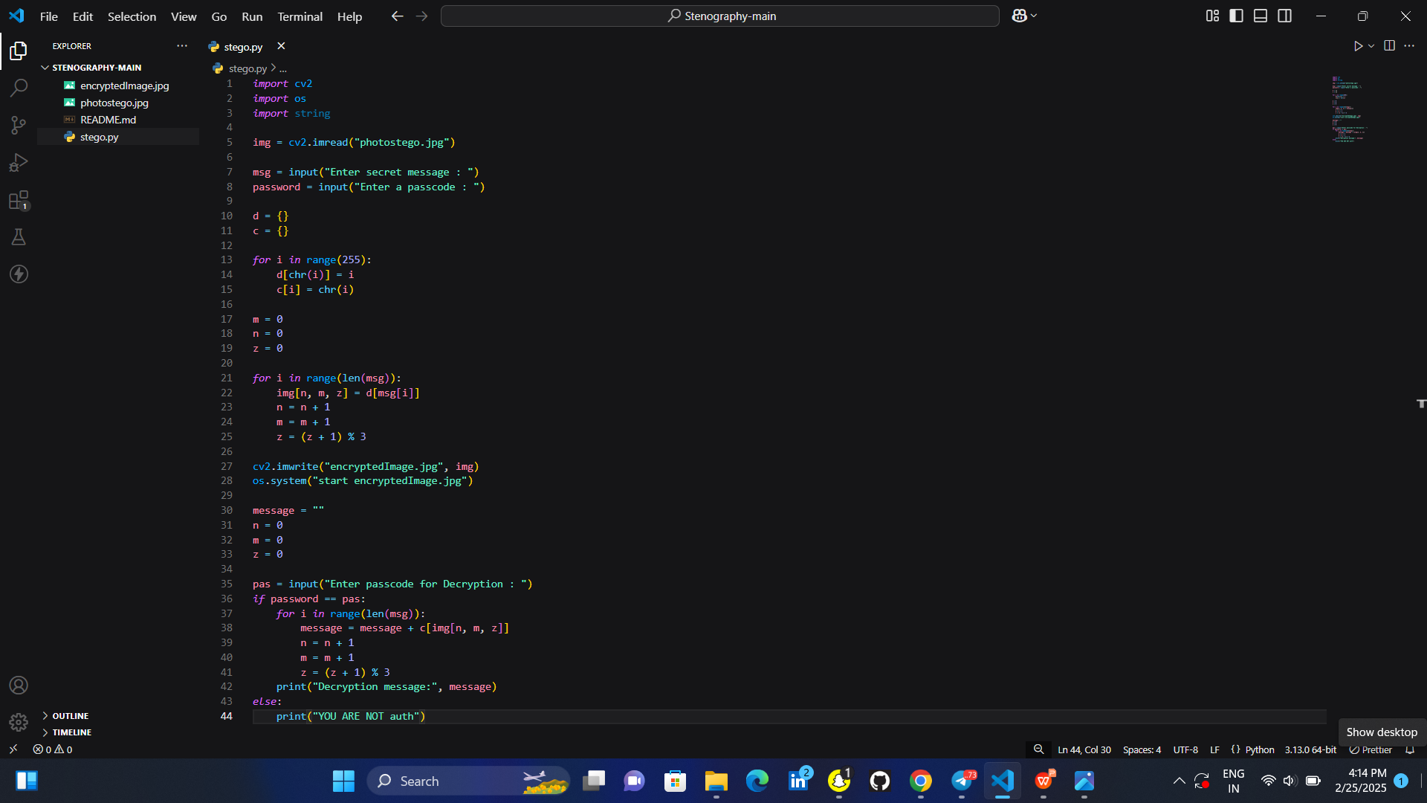
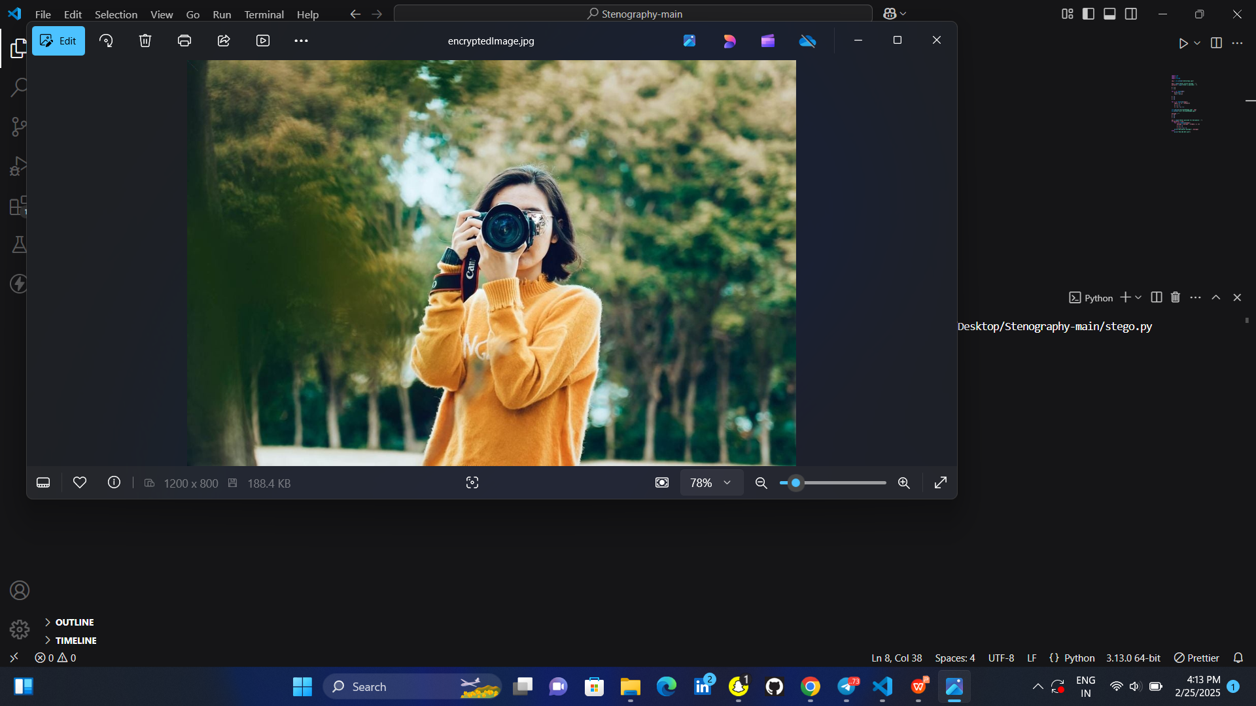
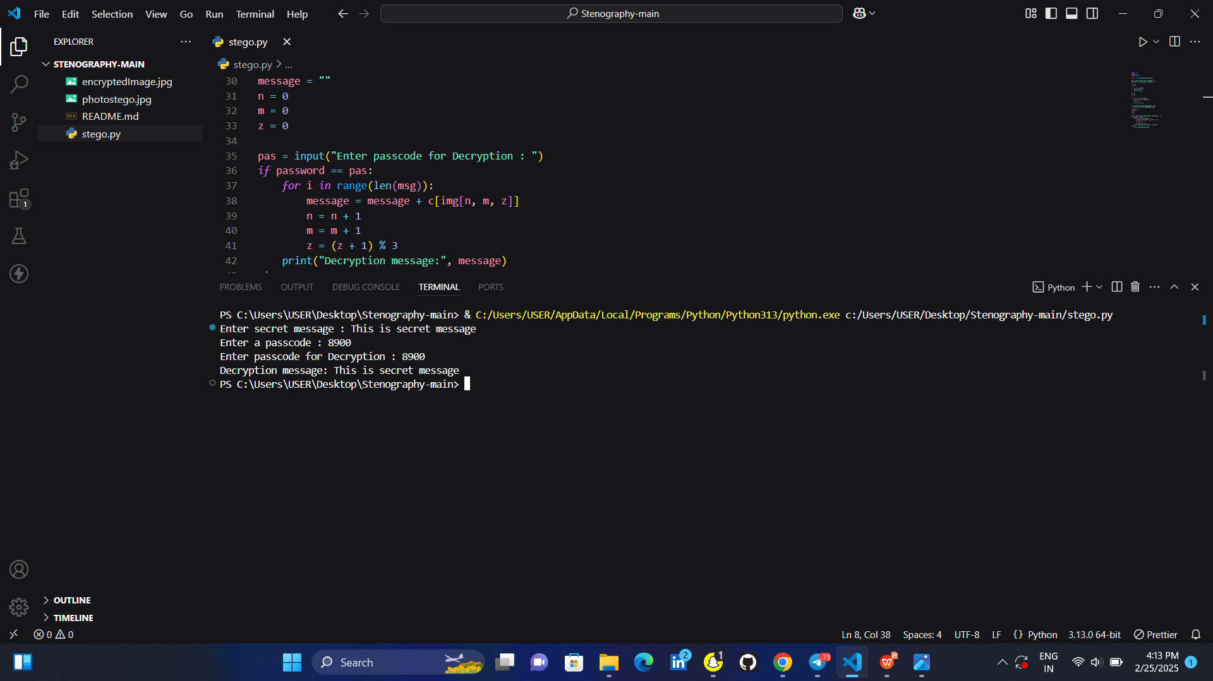
Results

Slide 8
Conclusion
This project demonstrates a basic yet effective image steganography technique for securely hiding messages in images. It offers a simple and user-friendly approach to secret communication. Future improvements could include advanced encryption, multi-layered encoding, and AI-based optimization for enhanced security.

Slide 9
GitHub Link
https://github.com/Nishi990/Stenography.git

Slide 10
Future scope(optional)
AI-Based Image Steganography – Use deep learning for better encoding techniques.
Support for Multiple File Formats – Extend support to audio and video files.
Mobile App Integration – Implement as a mobile application for on-the-go secure communication.
Cloud-Based Secure Messaging – Integrate with cloud platforms for secure data exchange.

Slide 11
THANK YOU

